Slide 1

Masking Up, Online
Anonymity Online
Tor vs. VPN vs. Proxy

Slide 2


Outline
VPN
Tor
Proxies
I2P
Compare/Contrast
Recommendations
Discussion

Slide 3
VPN
Stands for Virtual Privacy Network
a network connection that enables you to create a secure connection to another location, thereby allowing you to appear as if you were in another place
Your computer creates an encrypted virtual tunnel to the VPN server and all of your browsing appears as if it is coming from the VPN server.
All of the Internet traffic goes through this encrypted tunnel, keeping your data from being exposed to eavesdroppers between your computer and the VPN server.

Slide 4
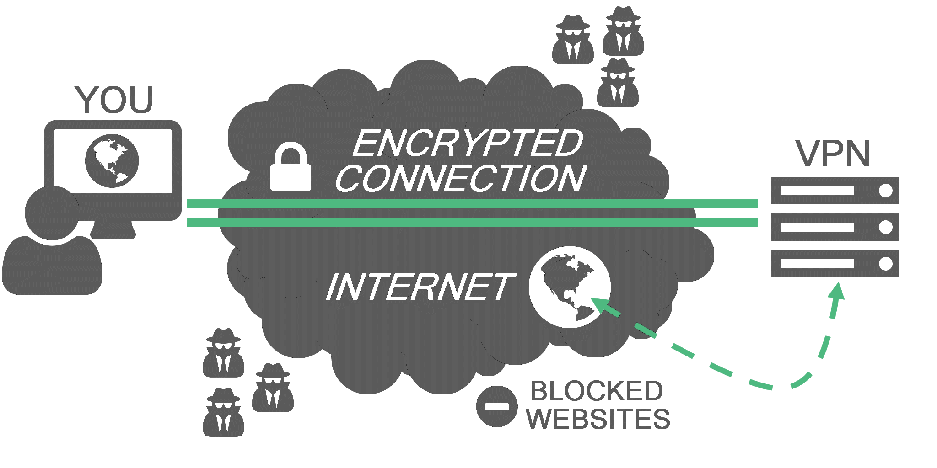
VPN Basics

Slide 5

Tor
Stands for The Onion Router
Protocol for making your internet
surfacing that much more anonymous
by bouncing your connection from
node to node all around the world

Slide 6
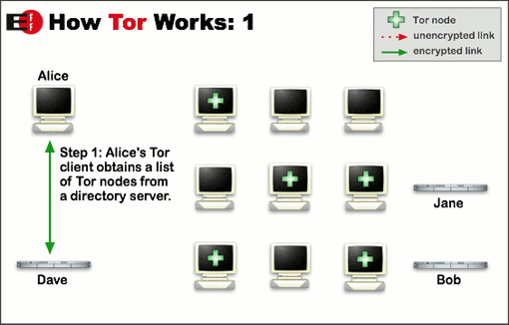
Tor 101

Slide 7
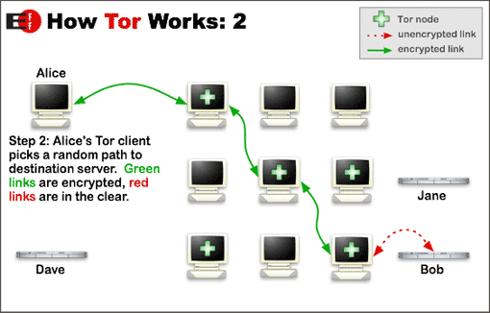
Tor 101

Slide 8
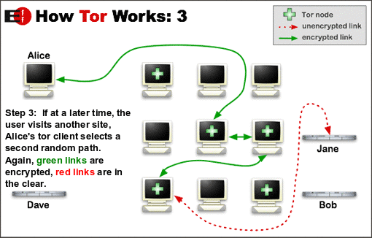
Tor 101

Slide 9
Proxy
A proxy, like a VPN, directs your traffic via another computer instead of your own.
While there are public and private proxy servers, only private proxies, usually paid, provide any type of stability or reliability.

Slide 10
I2P
I2P, short for the Invisible Internet Project, spawned in 2003, and is an anonymizing network that focuses on secure internal connections between users. Tor, on the other hand, largely focuses on allowing users to reach the regular internet anonymously (called the clearnet). In other words, we can think of Tor as being a path to the regular internet, while I2P seeks to create its own internet. In this light, we can already see that these two services are apples and oranges, thus there is no reason to say that one is better than another. Unfortunately this debate regularly takes place.

Slide 11
 | Tor | VPN | Proxy
What is it? | Protocol that bounces your connections around a network to hide your surfing | Protocol that connects you to a server b4 accessing site | Protocol that connects browser you to a server b4 accessing site
When do I use it? | Accessing websites anonymously, Dark Web | Anonymous online,access foreign content | Same as VPN, bypass filters
Difficulty of Set-Up? | Just a download/install! | Depends on company, can be simple though | Lots of instructions out there
Ease of Use? | Pretty easy, though maybe slow | Depends on company, can be simple though | Like using the web regularly!
Drawbacks | Slow, not impervious to tracking | Could be within U.S, could log your sessions | Bare bones privacy, many keep logs
Tor
VPN
Proxy

Slide 12
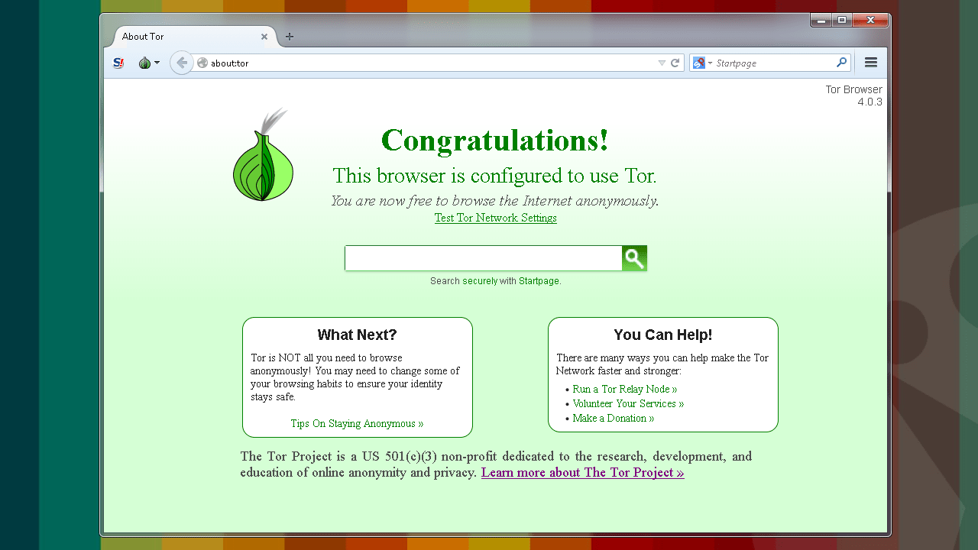
Recommendations
Tor
VPN
Policies
Thatoneprivacyguy
Privacytools.io

Slide 13

Let’s Talk About IT!

